Slide 1

Design Pattern
Search
Adapter
Truong Dang Minh Khue

Slide 2
Definition
converts the interface of a class into another expected interface.
Adapter Pattern

Slide 3

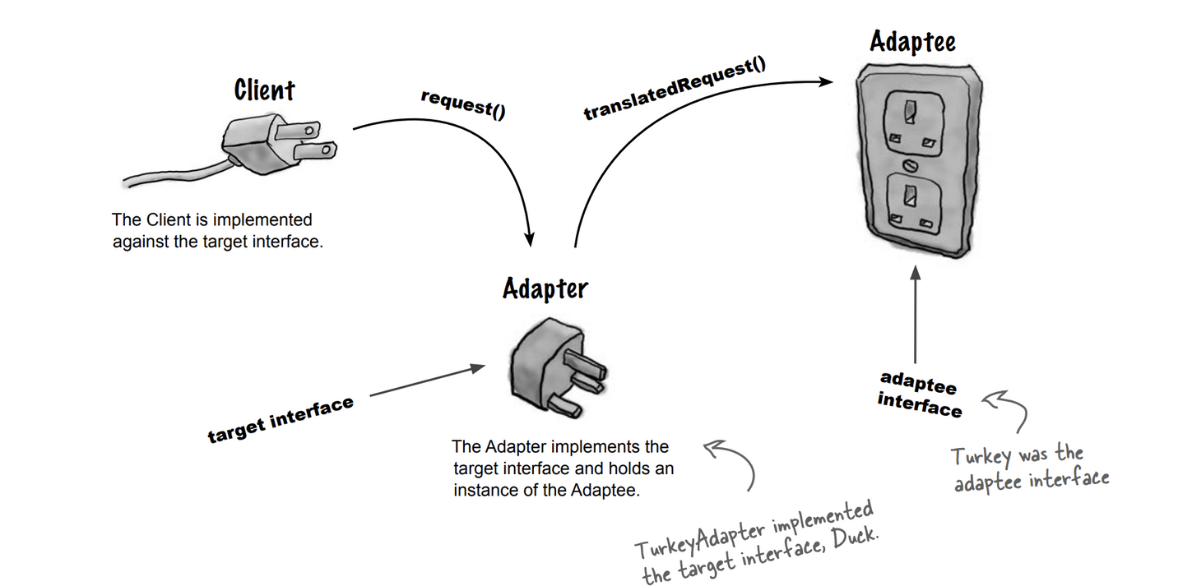
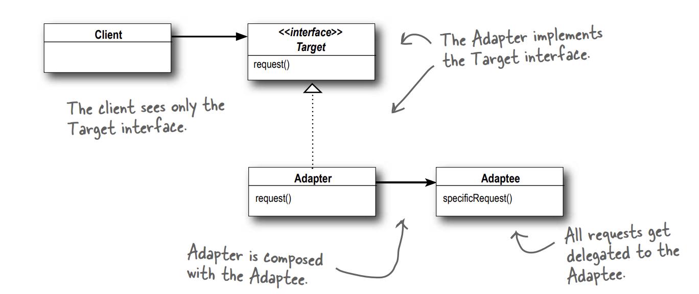


Slide 4
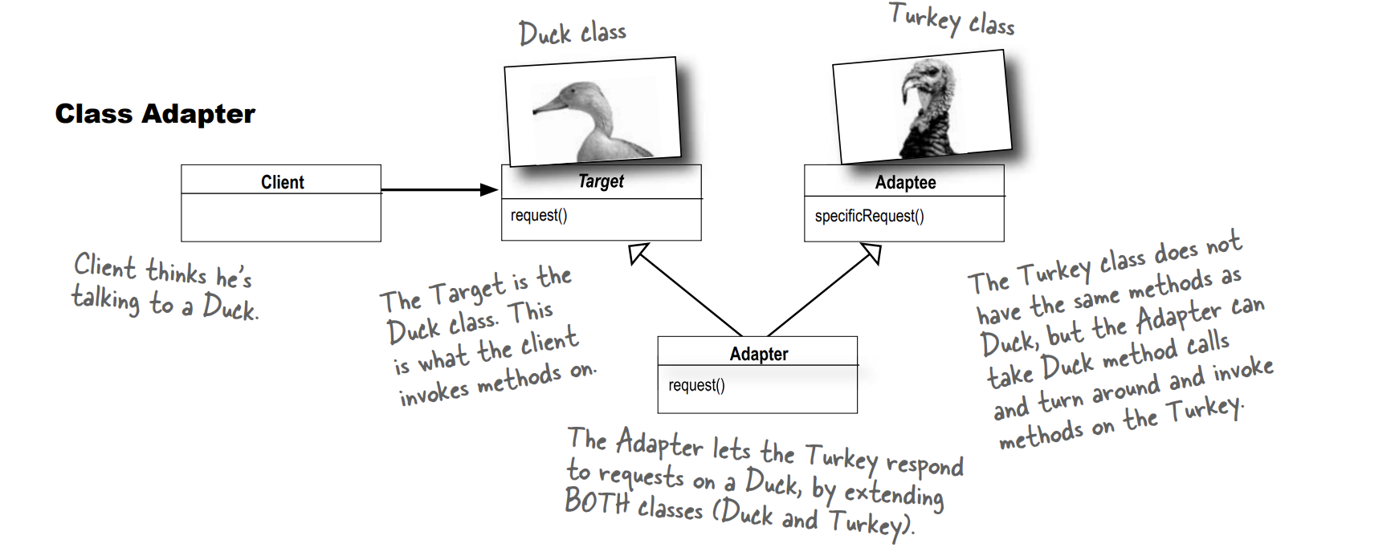

Slide 5



Comparison
The difference between
Decorator
vs.
Adapter
Pattern
Pattern

Slide 6
Thank you!
Until our next design pattern!

